Slide 1

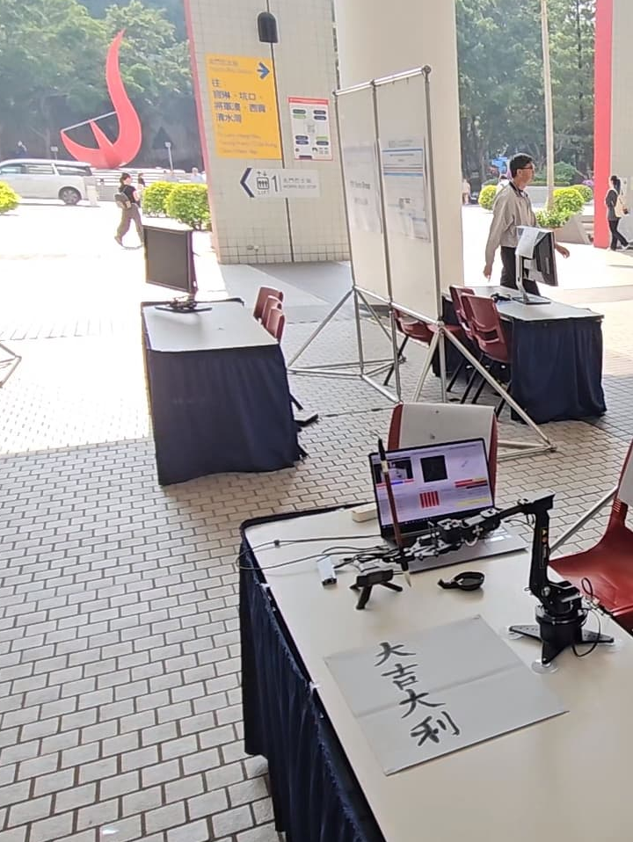
Empowering Robotic Calligraphy Through AI-Driven 3D Path Planning
Presenter: Cheung Dick Ho (UG17)
Supervisor: Professor Woo Kam Tim
Notes:
Good morning everyone, I am CHEUNG Dick Ho, Dicaprio from Group UG17 and this is my project, Empowering Robotic Calligraphy Through AI-Driven 3D Path Planning.

Slide 2
TABLE OF CONTENTS
01
02
03
04
Introduction & Background
Methodology
Final Results
Q&A
Notes:
(Skip)

Slide 3
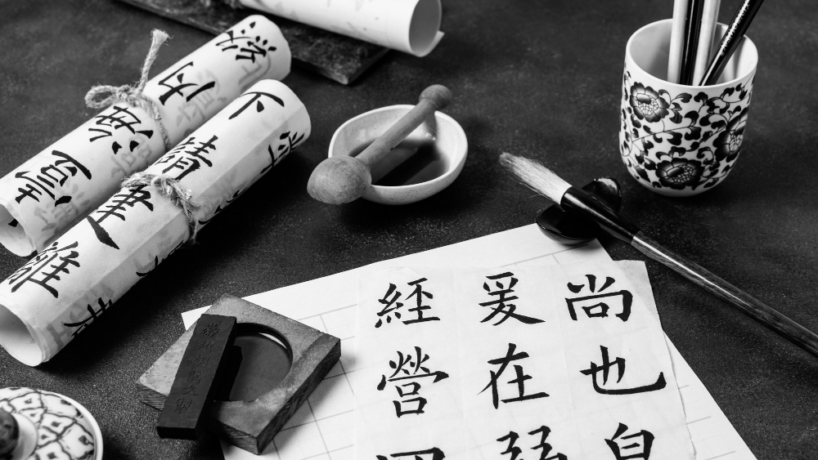
01
INTRODUCTION & BACKGROUND
Why I did this project?
Notes:
First, let’s start with the introduction and Background.

Slide 4

Chinese Calligraphy is an ancient art form
Cultural Heritage:
Practiced for thousands of years
Artistic Process:
Involves correct depiction of strokes and brush dynamics.
Artistic Intent:
Each stroke conveys emotion and meaning.
Notes:
Chinese calligraphy is an ancient art form that has been practiced for thousands of years. It involves not only the precision of controlling the brush to write the characters but also the ability to convey deep emotions and meanings.

Slide 5
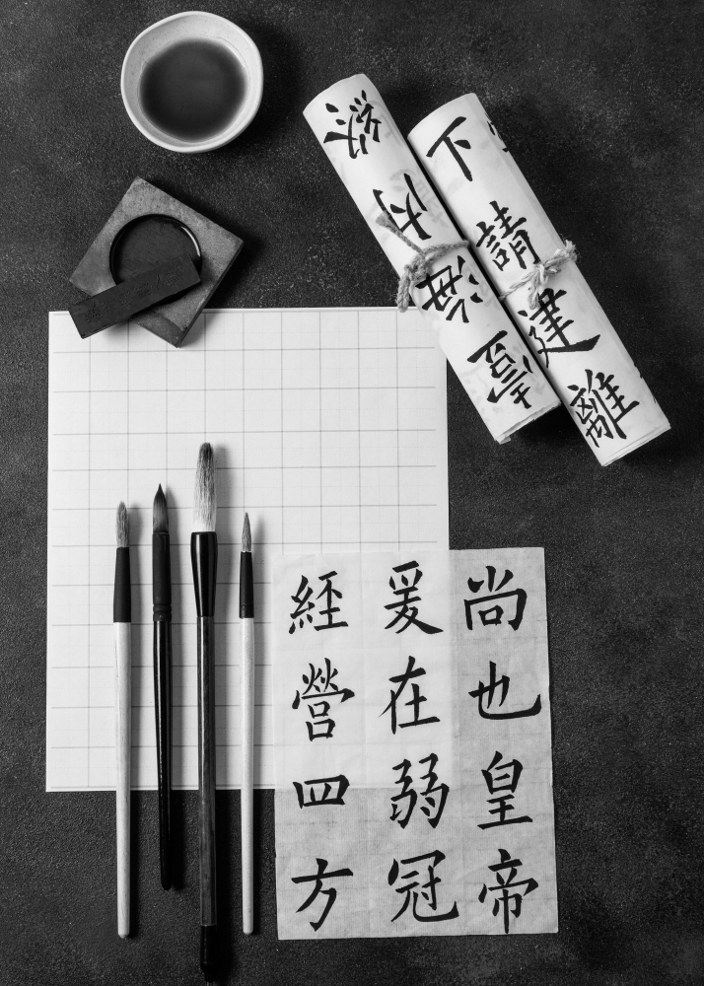
Challenges of
Robot Calligraphy
Precision:
Achieving human-like accuracy in strokes.
Brush Dynamics:
Mimicking pressure, angle, and speed control.
Artistic Quality:
Maintaining high levels of artistic expression.
Significant Hurdle:
Bridging human artistry and robotic capabilities.
Notes:
Thus, it presents a significant challenge for robotic calligraphy, as we must achieve human-like accuracy in controlling the brush’s pressure, angle, and speed, while also expressing the artistic qualities of the words it writes. Robot calligraphy bridges the gap between engineering and cultural artistry, empowering machines to honor this timeless tradition.

Slide 6
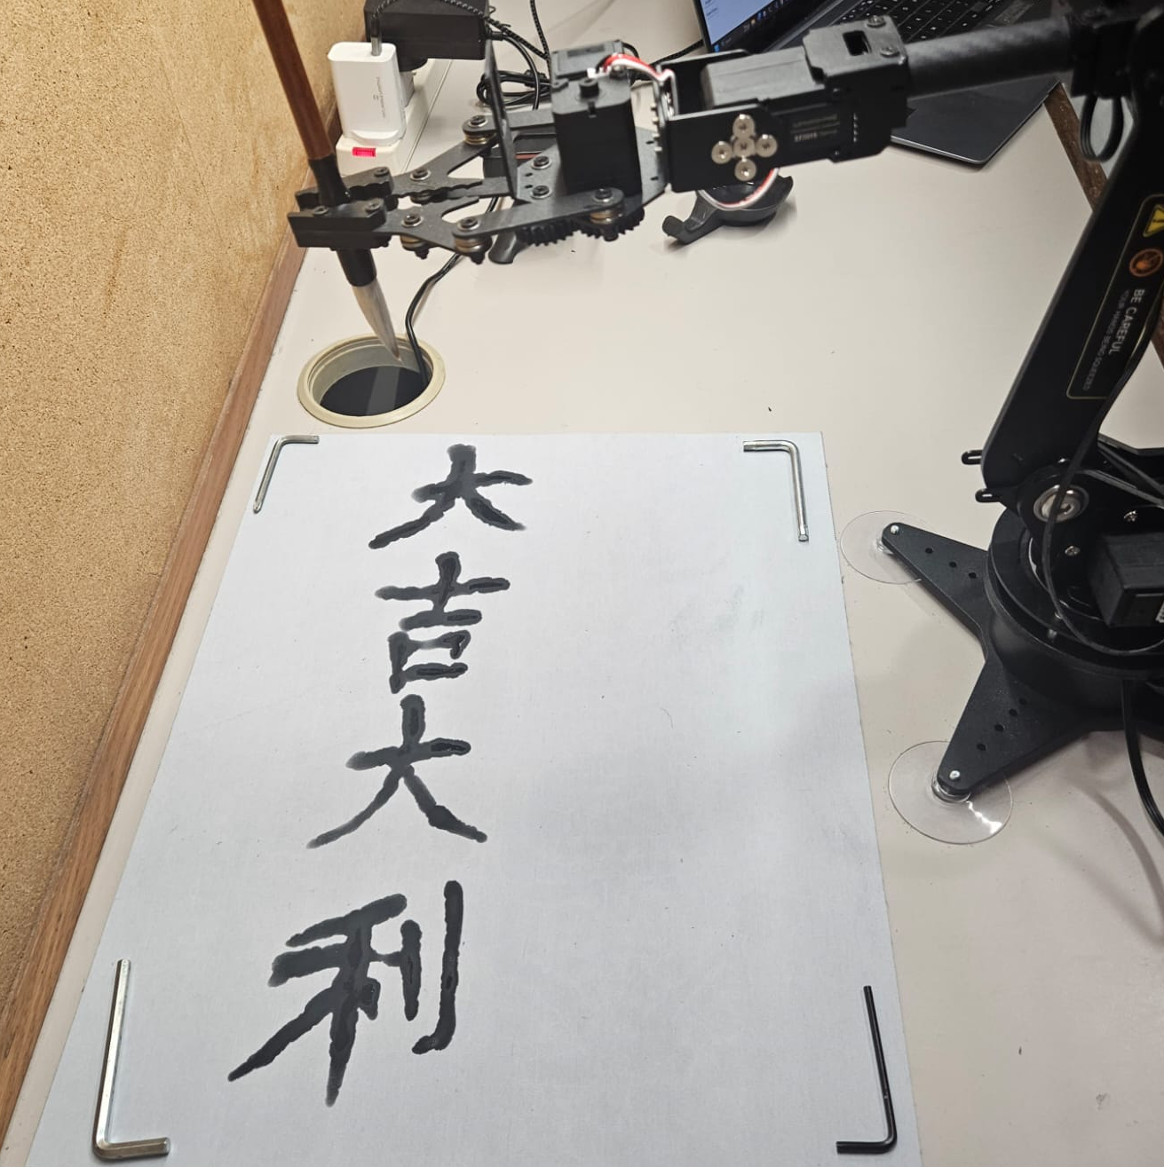

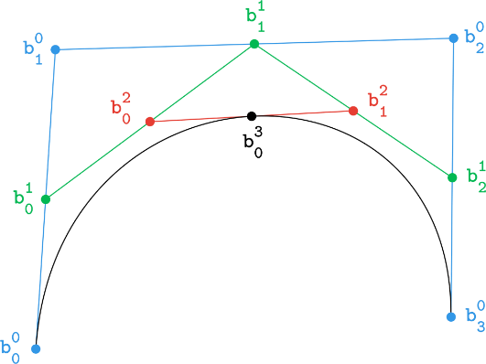
Overview
AI-Driven
3D Path Planning
Robot Calligraphy
LLM Generate
4 Chinese Characters Idioms
(四字揮春)
Smooth 3D Hermite Spline Trajectory
Write Chinese Calligraphy with Robotic Arm
Notes:
So, the main objective of my project is to use ChatGPT to generate Fai Chun text prompts, use Smooth 3D Hermite Splines to convert the Chinese characters into robot trajectories, and use Robotic Arm to turn the simulated paths into reality.

Slide 7
Why 3D Path Planning?
Because Height of Brush affects Stroke Thickness
Brush Lift Up = Thin strokes
Brush Press Down = Thick strokes
Notes:
You might ask, Why is it 3D Path Planning when we write on a 2D paper? It is because if we draw a line with the Chinese Calligraphy brush high in the air, the stroke drawn would be thin. If we press the brush onto the paper, the stroke would be thick. So, the thickness of the resulting brush strokes it draws can show the height of the trajectory, hence visualizing all 3 dimensions of the path planning algorithm.

Slide 8
02
METHODOLOGY
How I did this project?
Notes:
Now, let’s talk about how my project works.

Slide 9
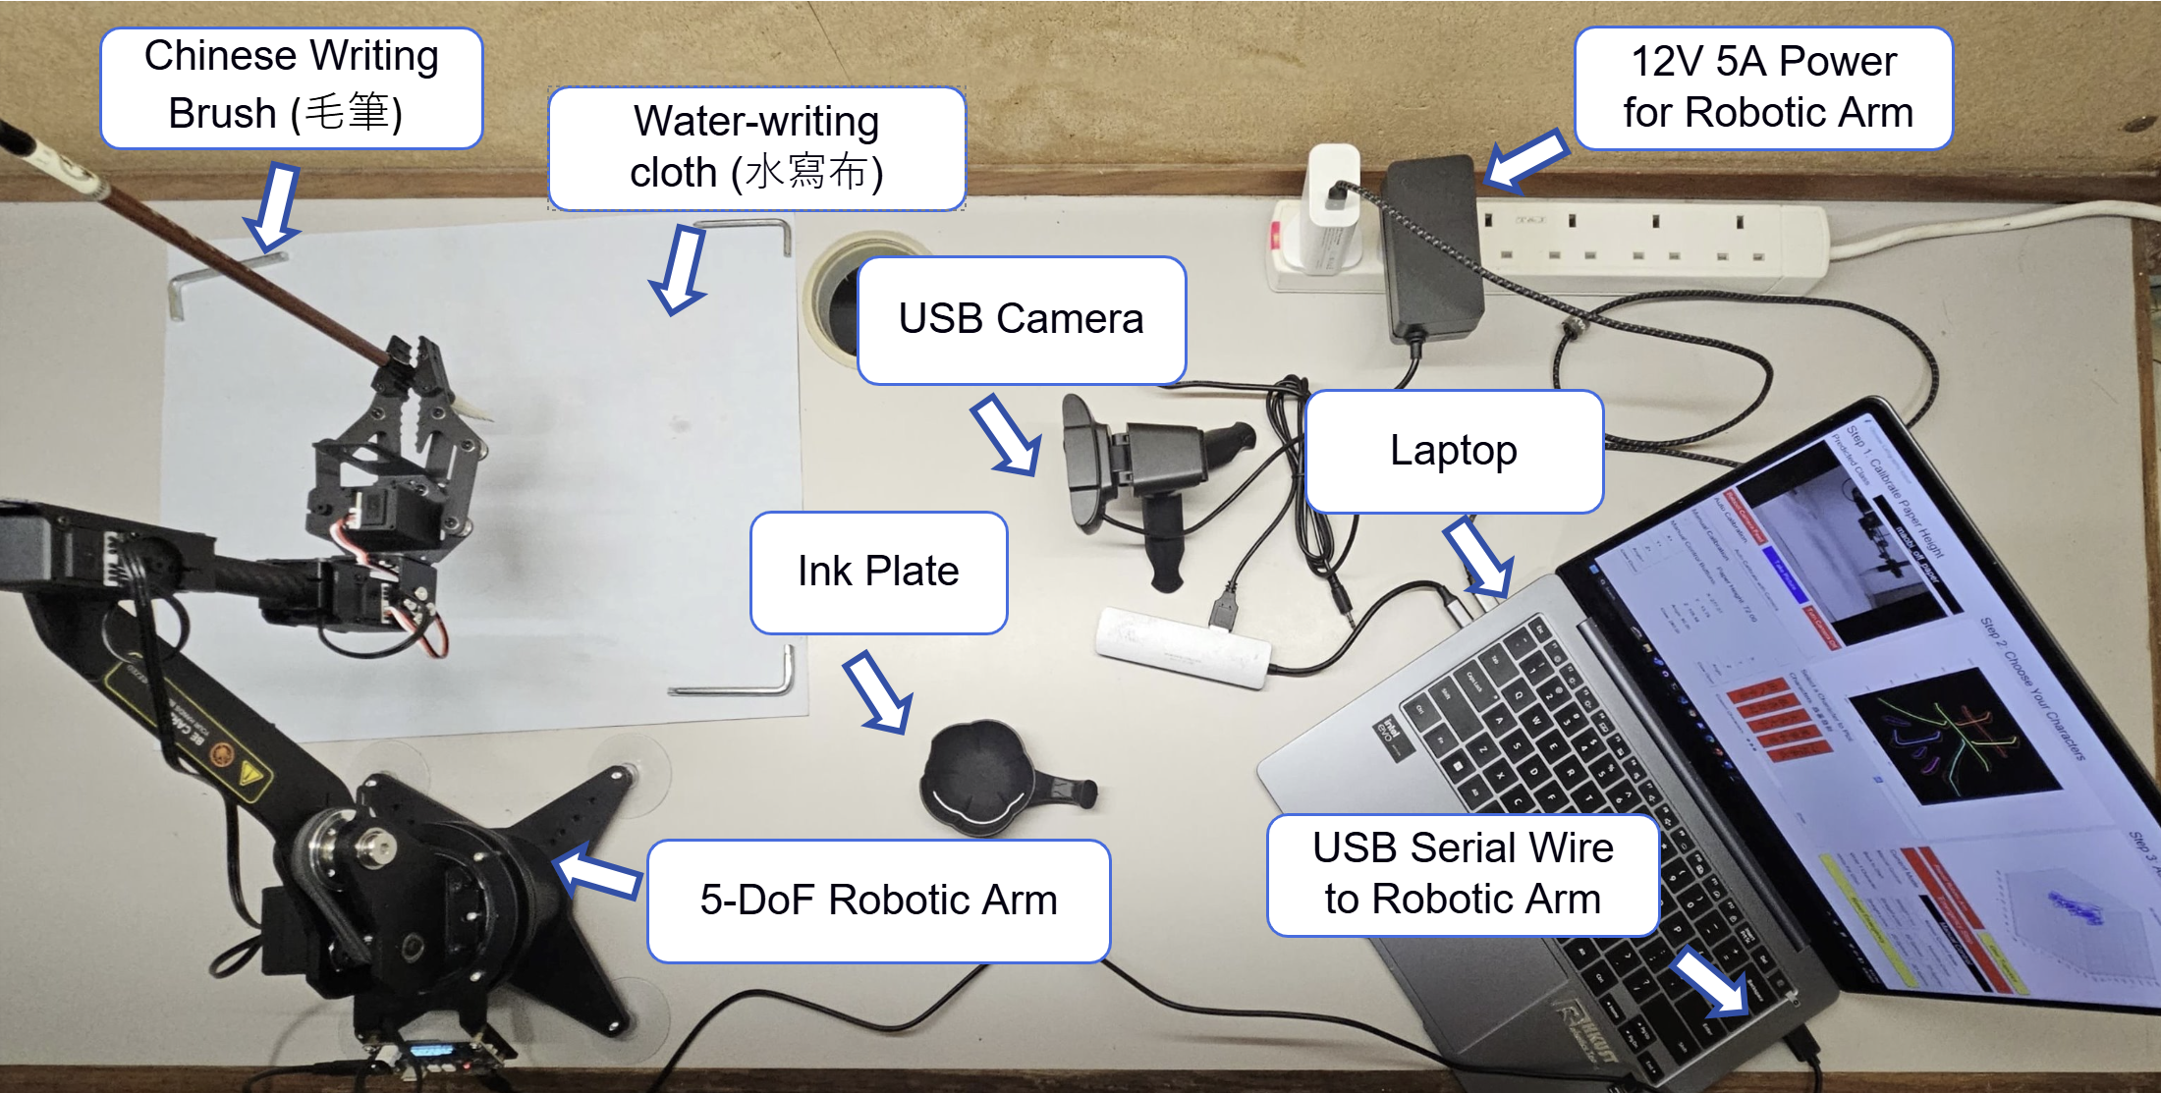
Experiment Setup
Notes:
So, this is the setup of my project. There is the robotic arm on the left that writes Chinese calligraphy on the white paper, and my laptop on the right with a UI that controls the whole system.

Slide 10
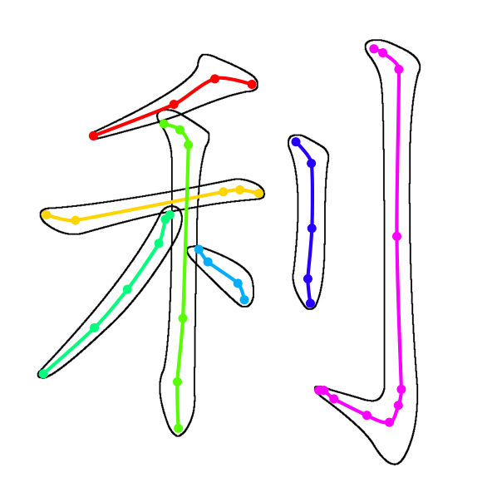
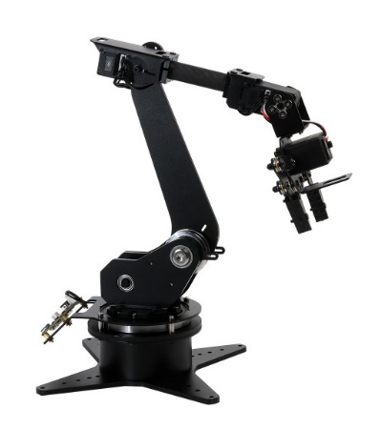
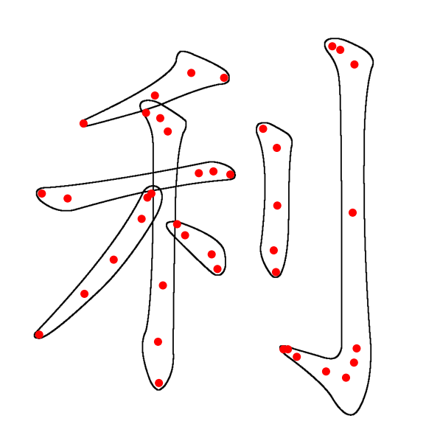


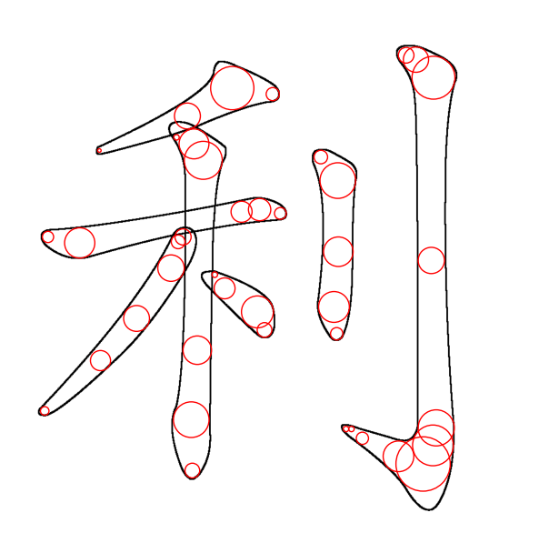
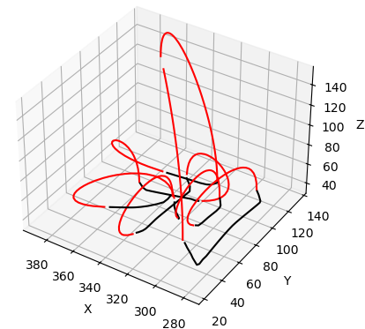
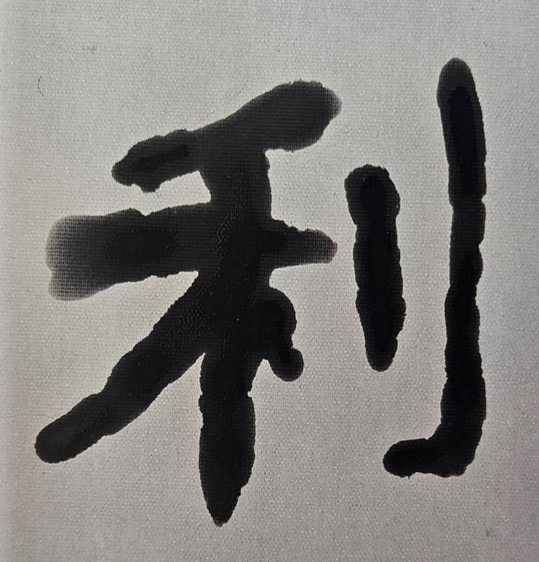
Workflow
Control Point Generation
Trajectory Generation
Robot Manipulation
Fetch 2D
Control Points
3D Hermite Splines
Control Robotic Arm
ChatGPT - 4o
Q: 幫我寫一個關於新年
的四字詞語。
(Help me write a four-
character idiom related
to Chinese New Year.)
Generate 3D
Control Points
Add Connecting
Hermite Curves
Chinese Calligraphy
A: 大吉大利
(Great luck
and great profit)
Notes:
This is the workflow of my system and I will talk about it in detail.

Slide 11
Generate Text Prompts with LLM
Control Point Generation
Trajectory Generation
Robot Manipulation
Fetch 2D
Control Points
3D Hermite Splines
Control Robotic Arm
ChatGPT - 4o
Q: 幫我寫一個關於新年
的四字詞語。
(Help me write a four-
character idiom related
to Chinese New Year.)
Generate 3D
Control Points
Add Connecting
Hermite Curves
Chinese Calligraphy
A: 大吉大利
(Great luck
and great profit)
Notes:
And I will talk about the ChatGPT part first.

Slide 12
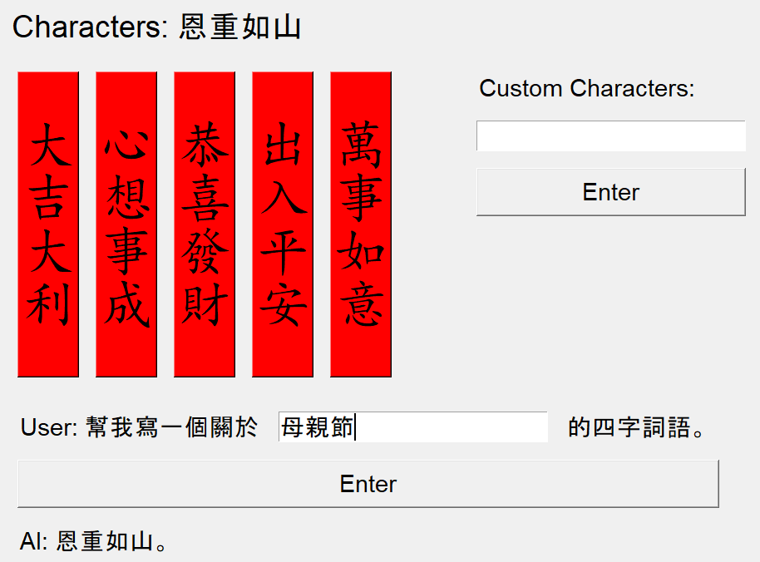
ChatGPT Suggest Idioms
ChatGPT - 4o
Q: 幫我寫一個關於母親節
的四字詞語。
(Help me write a four-
character idiom related
to Mother’s Day.)
A: 恩重如山
(Gratitude as heavy
as a mountain)
Notes:
This is a part of the UI that controls the robotic arm. This is the part where Users can input a topic or a festival into the prompt and ChatGPT can help you think and input some relevant Fai Chun for the robotic arm to write.

Slide 13

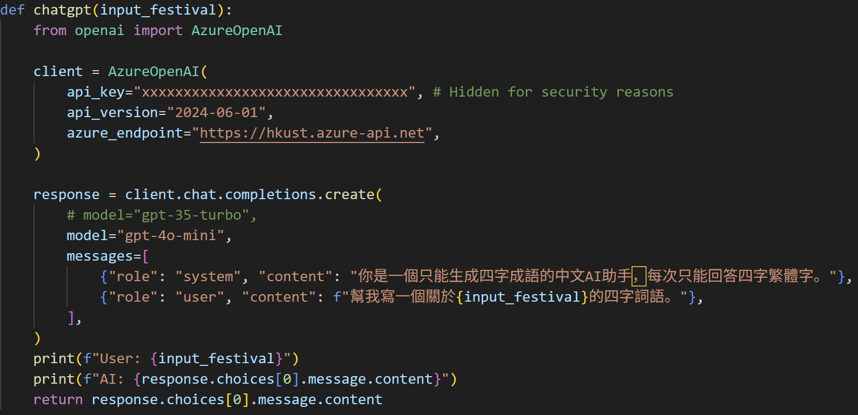
Powered by HKUST Azure OpenAI API
Easy & Free Access of ChatGPT
Empowers
Innovative Student Projects
Notes:
This ChatGPT feature is supported by HKUST OpenAI API services that is available to all HKUST students. The easy and free access of ChatGPT and other genAI empowers students like me to build innovative solutions with AI and to gain valuable experience.

Slide 14
Control Point Generation
Control Point Generation
Trajectory Generation
Robot Manipulation
Fetch 2D Control Points
3D Hermite Splines
Control Robotic Arm
ChatGPT - 4o
Q: 幫我寫一個關於新年
的四字詞語。
(Help me write a four-
character idiom related
to Chinese New Year.)
Generate 3D
Control Points
Add Connecting
Hermite Curves
Chinese Calligraphy
A: 大吉大利
(Great luck
and great profit)
Notes:
The next part is to convert the Chinese characters into control points

Slide 15
Fetch 2D Control Points
From Make Me a Hanzi Dataset
Notes:
I fetch the 2D control points of the chosen Chinese characters from an open-source dataset called Make Me a Hanzi. It includes the red control points and the black boundary in stroke order.

Slide 16

Calculate 3D control points
using Largest Fitting Circles
Notes:
So, I developed a largest fitting circles algorithm to convert the 2D control points to 3D. From each red control points, I increases the radius of the circle until it touches the boundary of the stroke. The size of these circles represent the stroke thickness, thus we can calculate their corresponding height of the Chinese calligraphy brush, which is the Z coordinates. So, we have 3D control points.

Slide 17
Trajectory Generation
Control Point Generation
Trajectory Generation
Robot Manipulation
Fetch 2D
Control Points
3D Hermite Splines
Control Robotic Arm
ChatGPT - 4o
Q: 幫我寫一個關於新年
的四字詞語。
(Help me write a four-
character idiom related
to Chinese New Year.)
Generate 3D
Control Points
Add Connecting
Hermite Curves
Chinese Calligraphy
A: 大吉大利
(Great luck
and great profit)
Notes:
With the control points, we connect them together into a smooth trajectory for the robotic arm

Slide 18
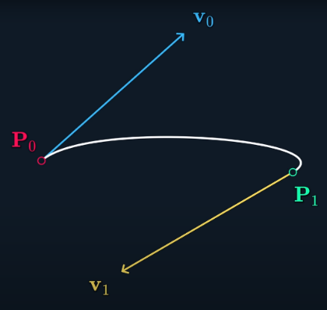
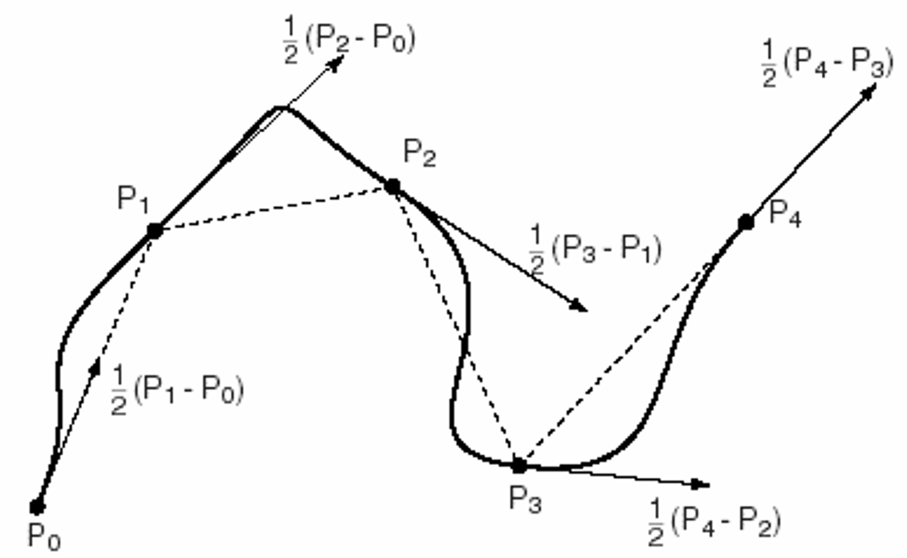
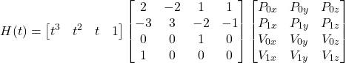

CONCEPTS
Hermite Curve
Catmull-Rom Spline
I connect 2 control points together with Hermite curve.
But we are missing v0 and v1
So, I uses Catmull-Rom Spline to calculate v0 and v1 to connect multiple Hermite curves
Notes:
I uses Hermite curve, which is a variant of Bezier curve, to connect 2 control points together. As there are more than 2 control points in a stroke, I tried to use Catmull-Rom Spline to calculate the control velocities v0 and v1 of the Hermite curve to connect multiple Hermite curves together.

Slide 19
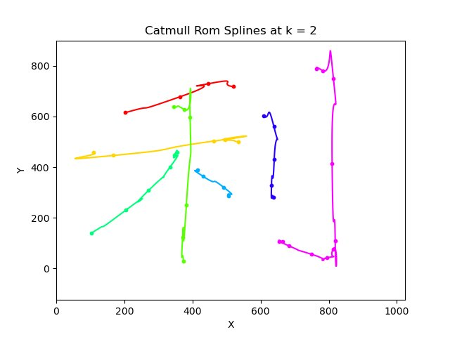
But Catmull-Rom Spline is not good
Notes:
However, Catmull-Rom Spline creates these strange backward movement as the control points are not uniformly spaced.

Slide 20
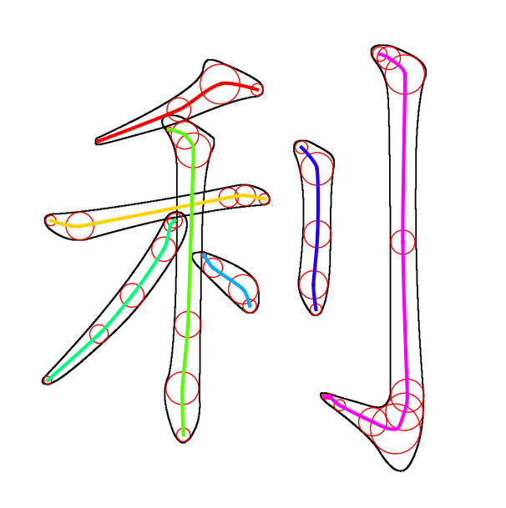
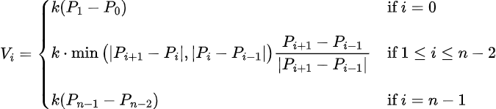
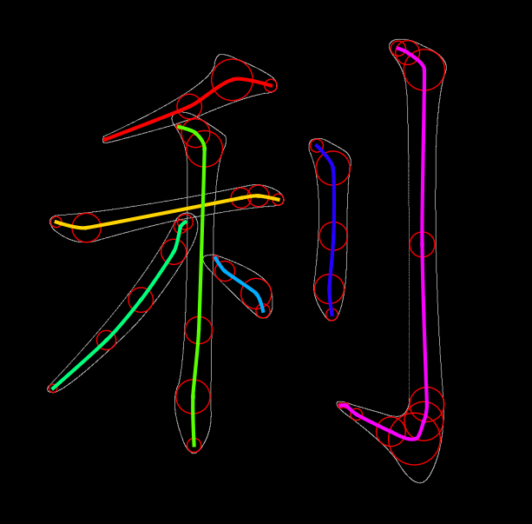
Modified Catmull-Rom Spline
Notes:
So, I modified the Catmull-Rom spline by limiting the magnitude of the control velocities to the distance to the closest control points. This prevents those backward movement and this is the result.

Slide 21
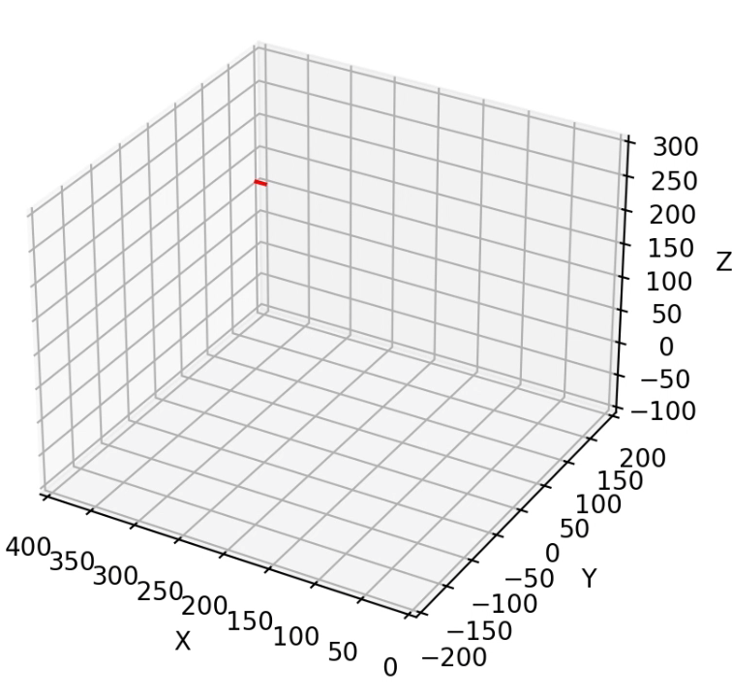
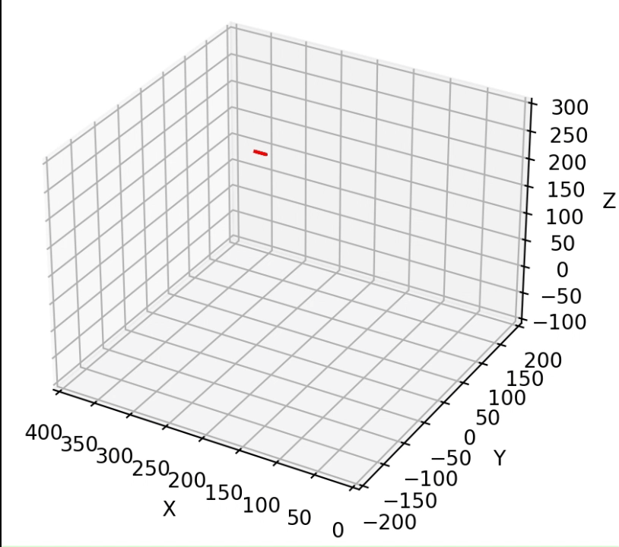
Connecting Hermite Curves
First version for 2D Spline Algorithm
Final version for 3D Spline Algorithm
Notes:
After connecting the control points within a stroke, I added these red connecting Hermite curves to control it to lift up the brush and go to the next stroke. Originally, I uses this Hermite curve that directly goes up and down to connect them. However, the sudden change of direction from going horizontally along the paper to vertically up is not smooth. Therefore, I modified the starting velocity vector into this horizontal along the previous movement direction to make it smoothly lift up the brush with G1 continuity.

Slide 22
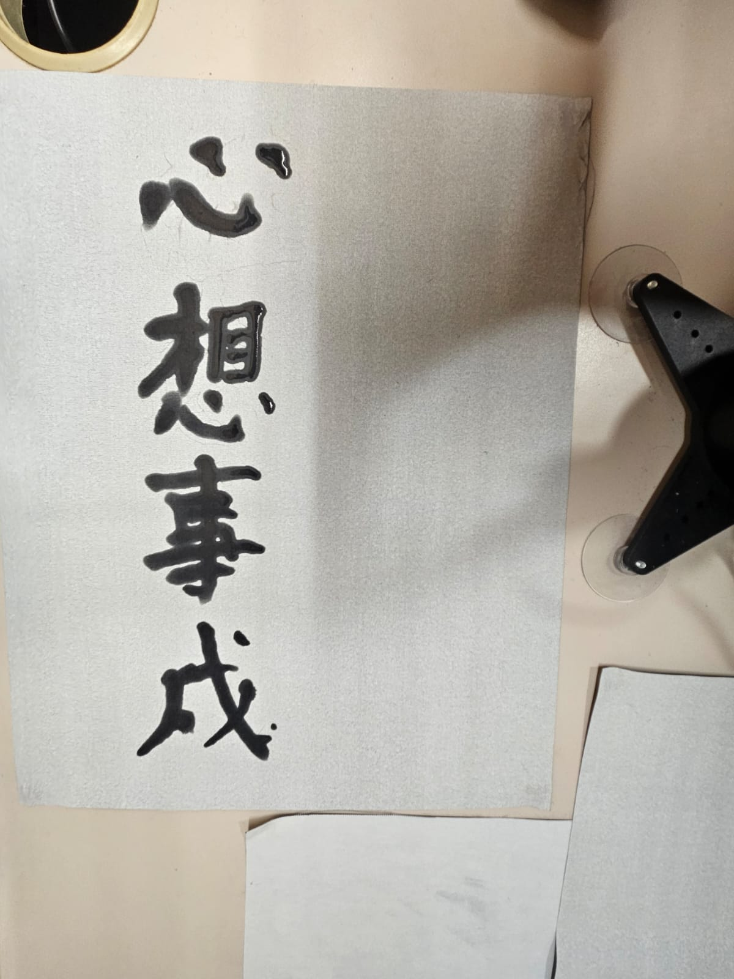
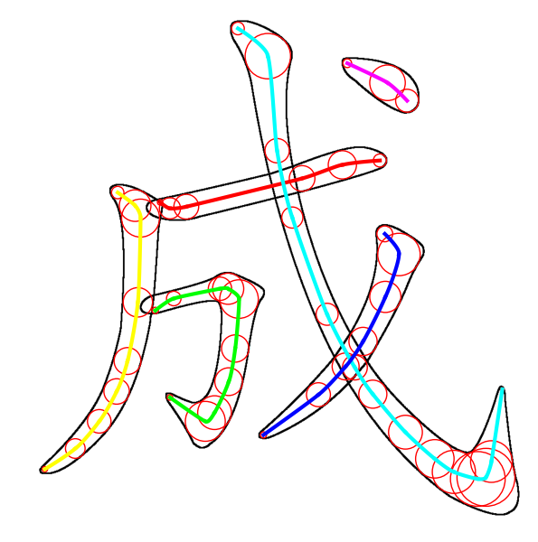
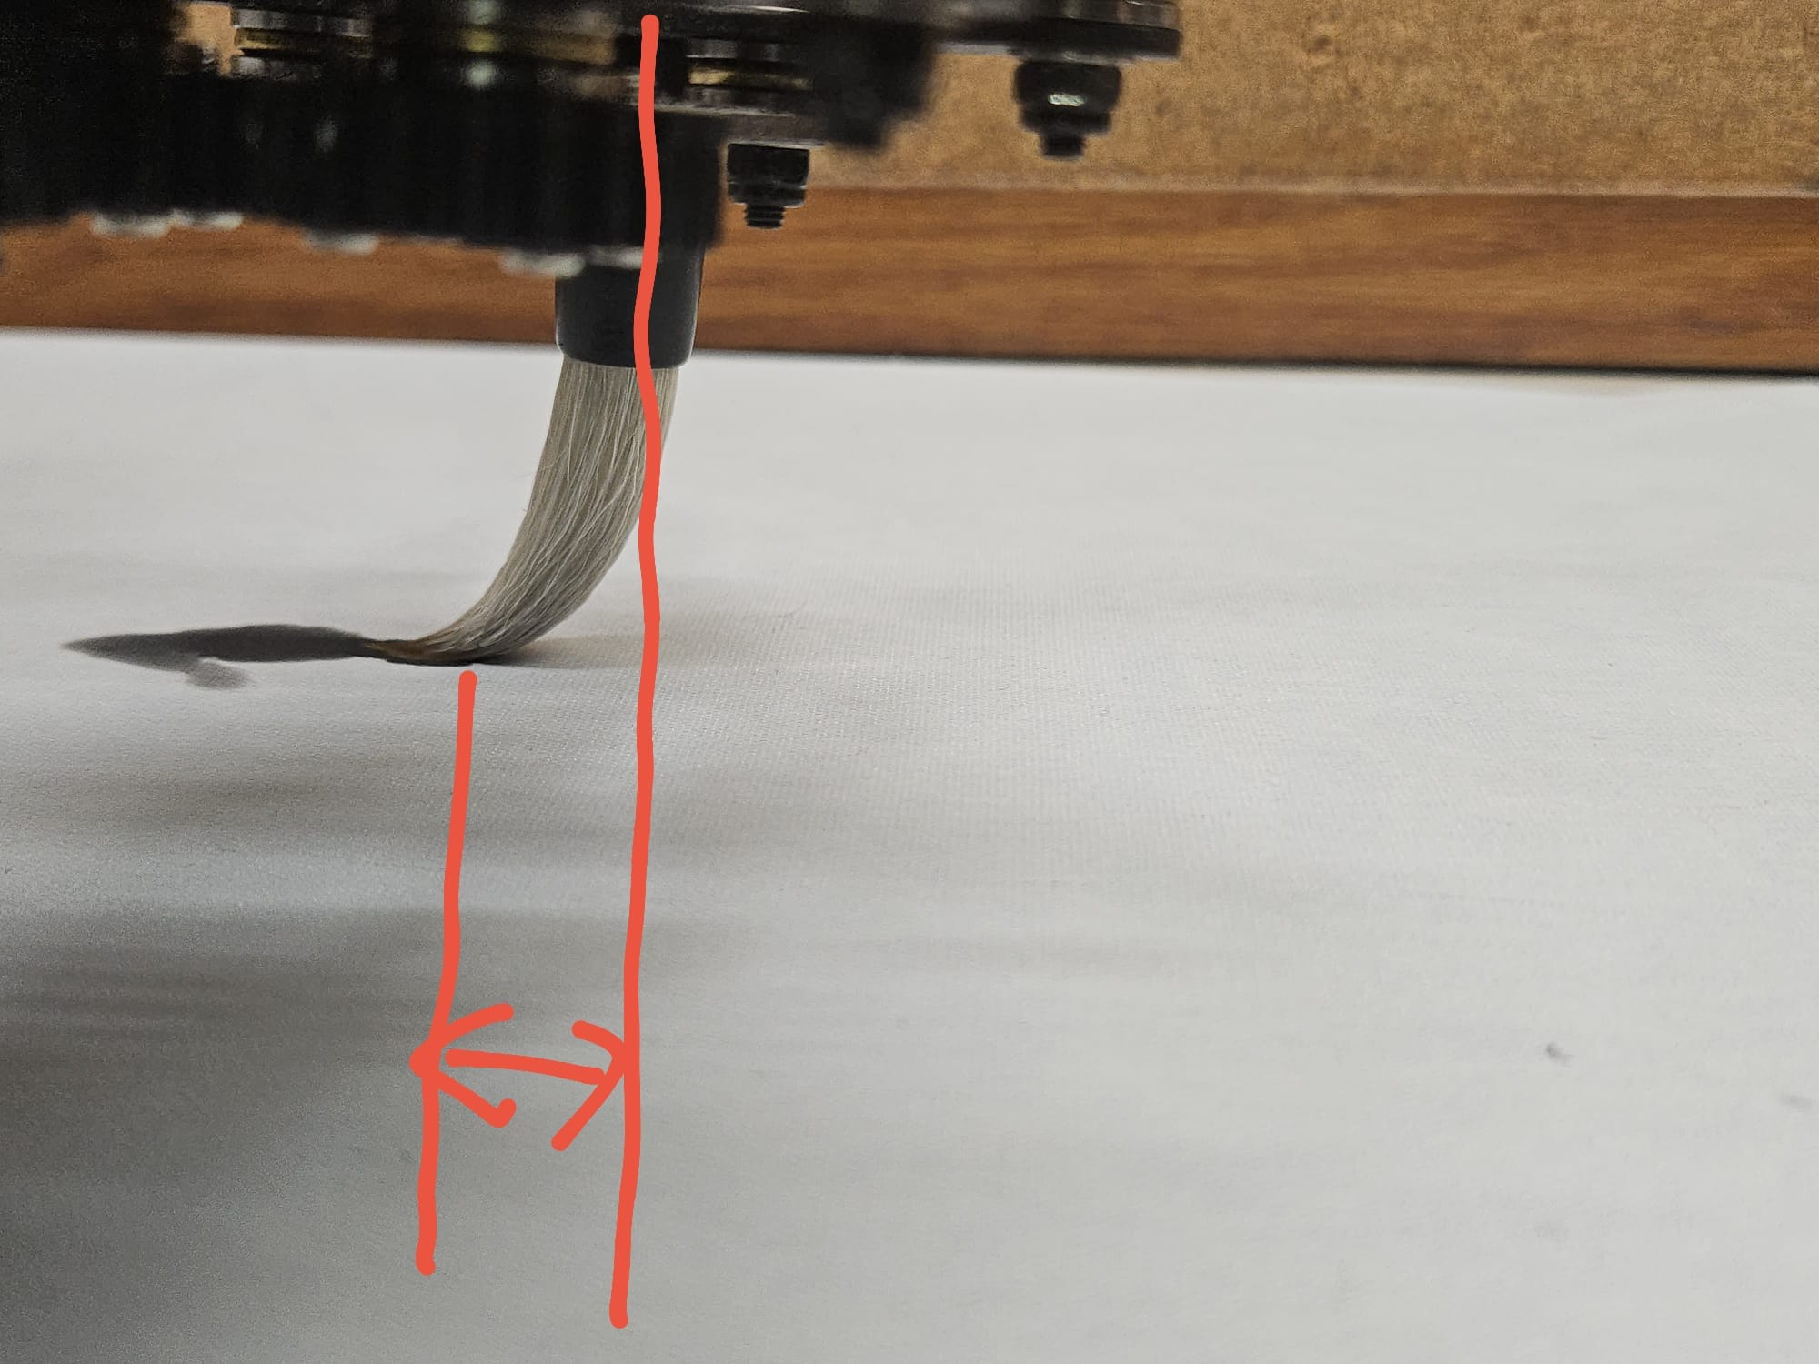
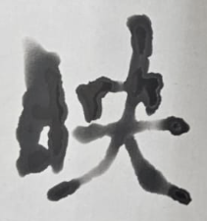
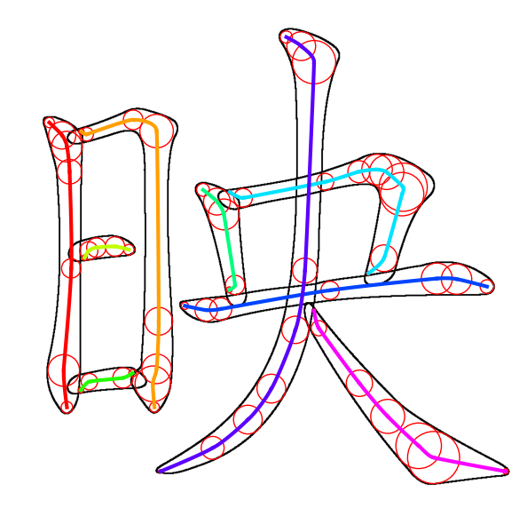
Brush Correction Algorithm
ERROR!
Notes:
After some testing, I found that the reason why it can’t write complex strokes clearly is because there is an error distance between the brush body and the brush tip. This cause it to move diagonally when it needs to move in a L shape. I thought of a way to correct this error AFTER I submitted my final report so this is not included in the report.

Slide 23
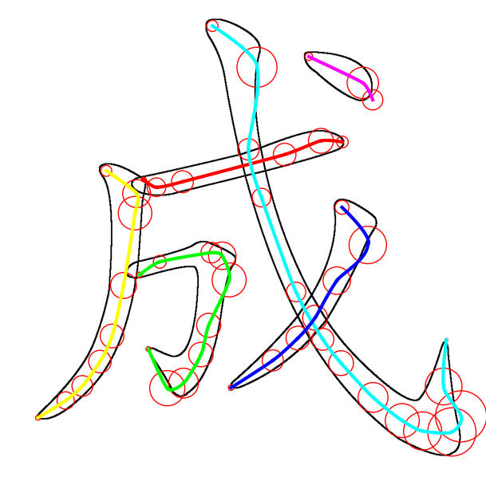
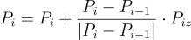
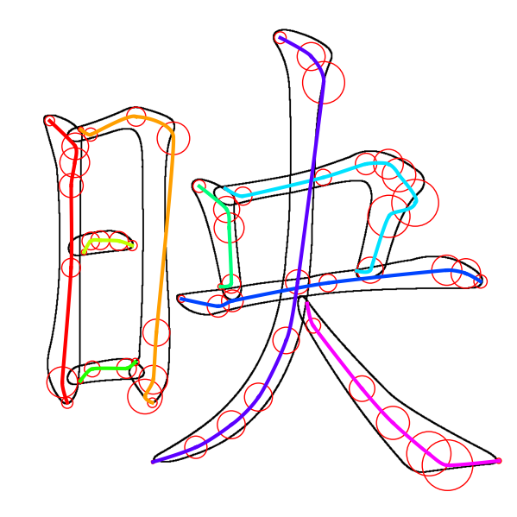
Brush Correction Algorithm
Notes:
So, I shift the original control points in the direction from previous point to current point. So, if it is a straight line, the shifted position is still on the line. But if the line is in L-shaped, it would go a little bit outward to compensate the error.

Slide 24
Robot Manipulation
Control Point Generation
Trajectory Generation
Robot Manipulation
Fetch 2D
Control Points
3D Hermite Splines
Control Robotic Arm
ChatGPT - 4o
Q: 幫我寫一個關於新年
的四字詞語。
(Help me write a four-
character idiom related
to Chinese New Year.)
Generate 3D
Control Points
Add Connecting
Hermite Curves
Chinese Calligraphy
A: 大吉大利
(Great luck
and great profit)
Notes:
This is the workflow of my system and I will talk about it in detail.

Slide 25
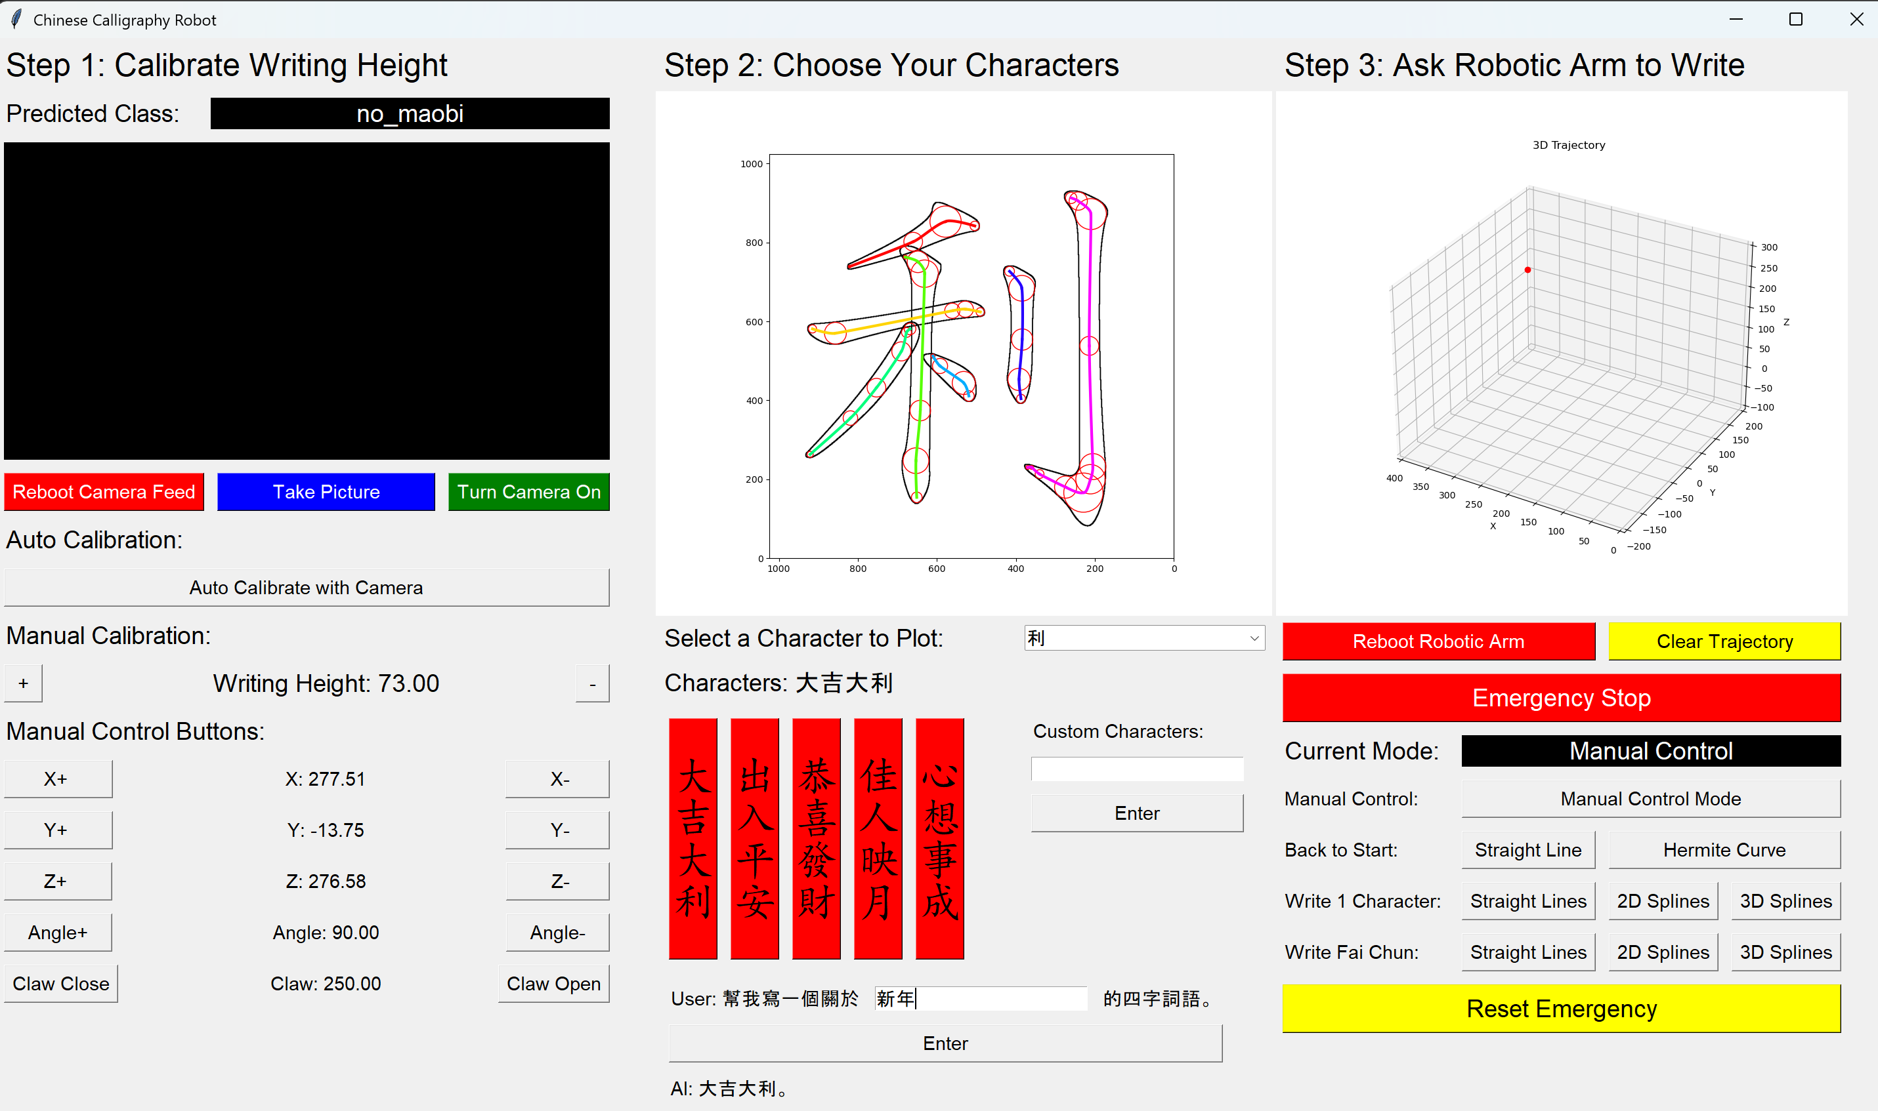
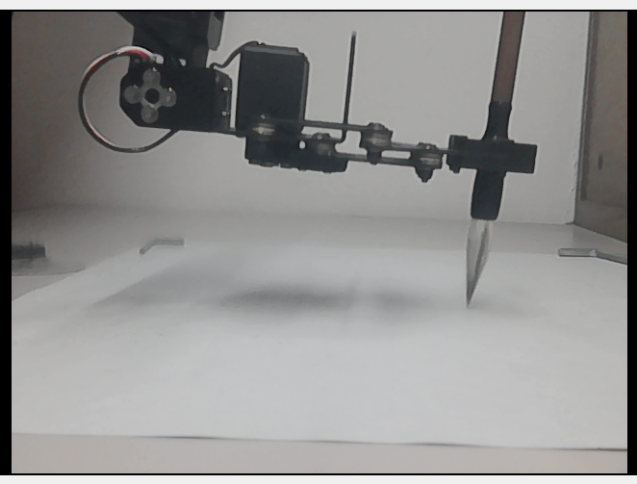
User Interface
Notes:
I created a simple UI to control the movement of the robotic arm. This is where the users can interact with ChatGPT and this is where the user can directly input what Fai Chun they want to write

Slide 26
03
FINAL RESULTS
How well it works
Notes:
My last objective statement is to evaluate the performance boost of this Bezier curve path planning when compare to traditional methods.

Slide 27
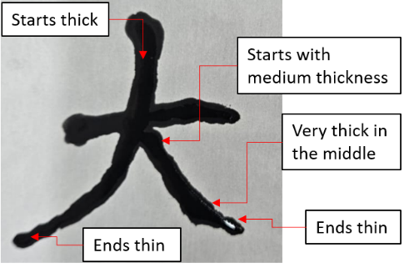
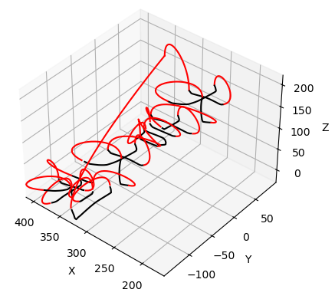
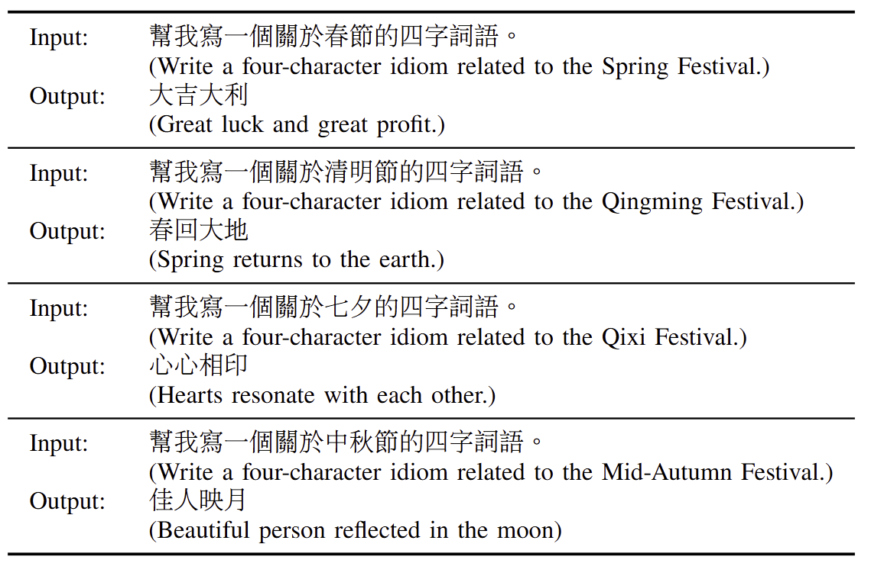
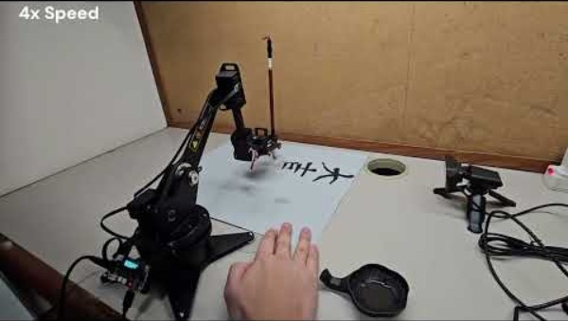
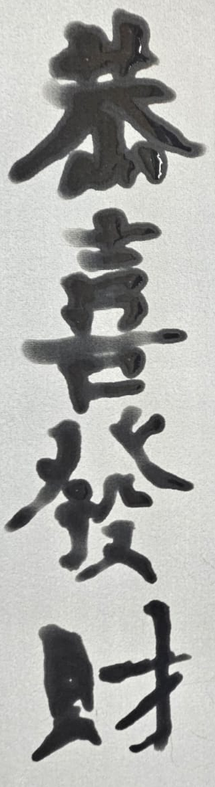
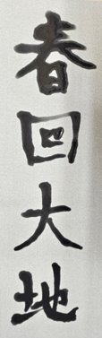

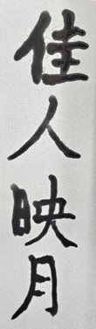
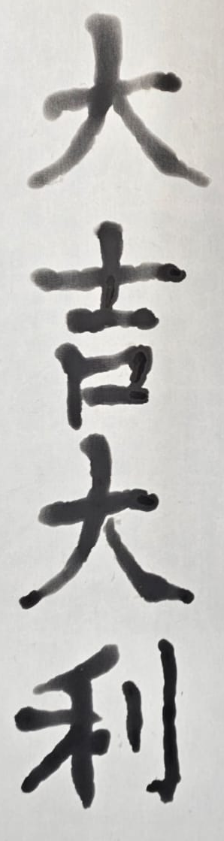
Some Test Results
Notes:
The final 3D Spline Algorithm has varying height, which creates varying brush thickness in the written words.

Slide 28
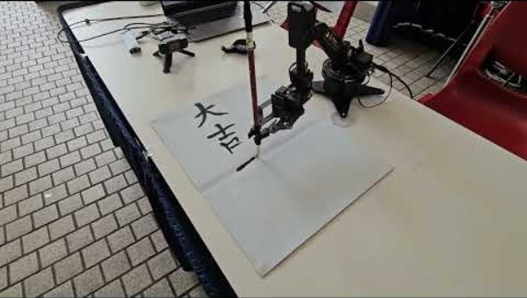
Demo in HKUST
Notes:
Here is a Demo in FYP Industry Day.

Slide 29
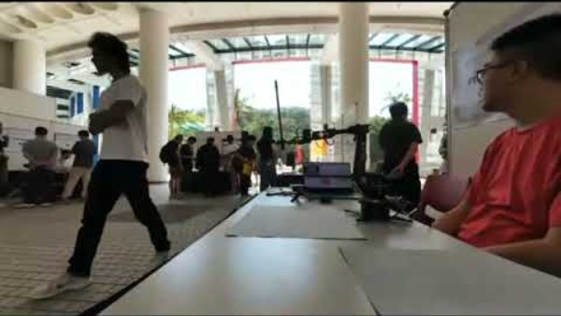
THANKS
Empowering Robotic Calligraphy Through AI-Driven 3D Path Planning
Presenter: Cheung Dick Ho (UG17)
Supervisor: Professor Woo Kam Tim
Notes:
And this is a timelapse of my FYP Industry day.

Slide 30
Questions & Answers

